Slide 1
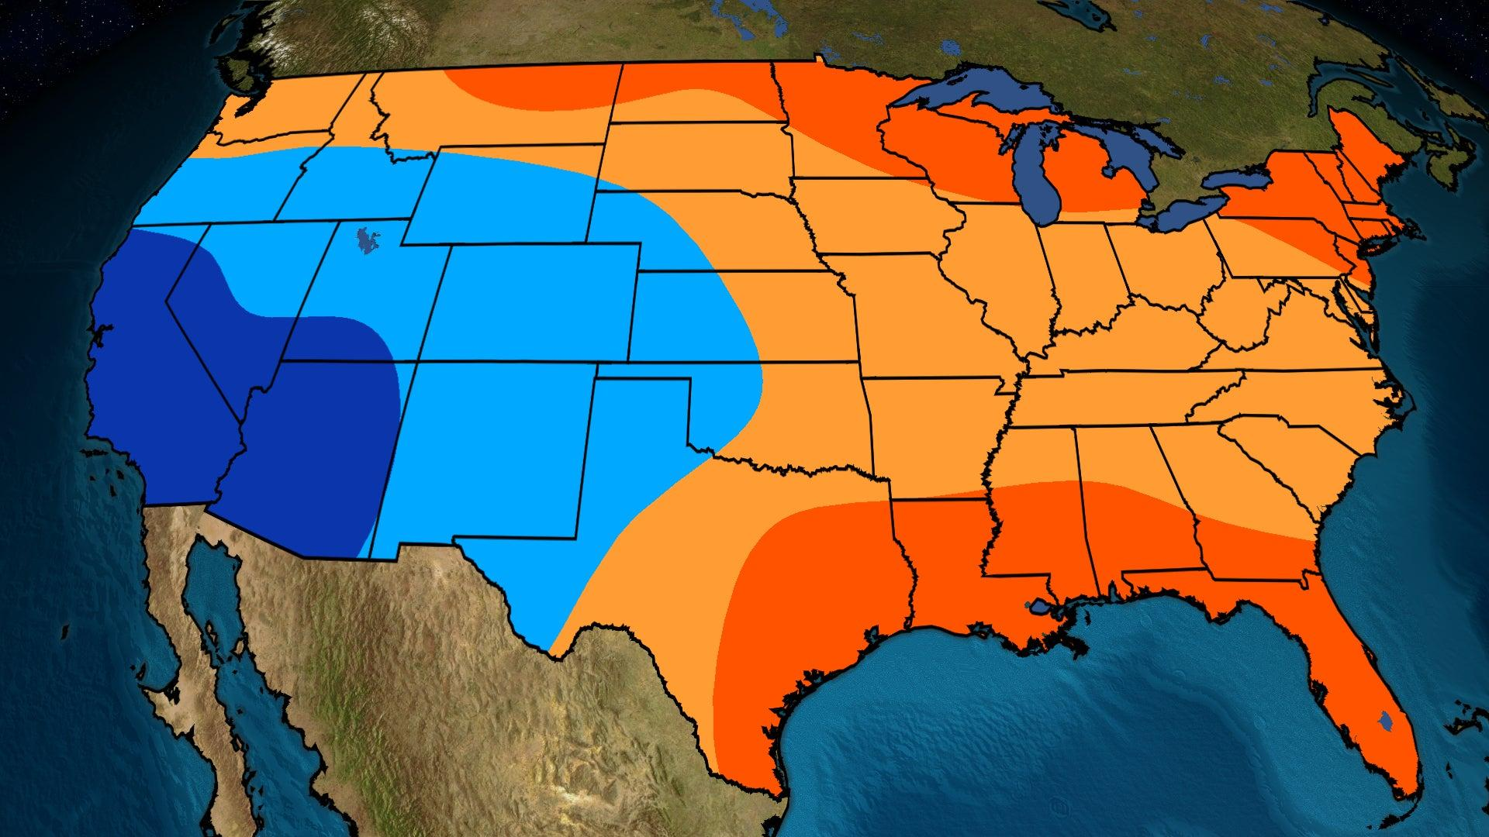
Data Challenge 2023

Slide 2
MAIN QUESTIONS OF INTEREST
When are scenarios when they overestimate the temperature? Underestimate?
When do weathermen make more accurate predictions?

Slide 3
HYPOTHESIS TESTING
H₀ : μ_{forecast} = μ_{observed}
H₁ : μ_{forecast} ≠ μ_{observed}
p-value: 0.0005
∴ We reject the null hypothesis here

Slide 4
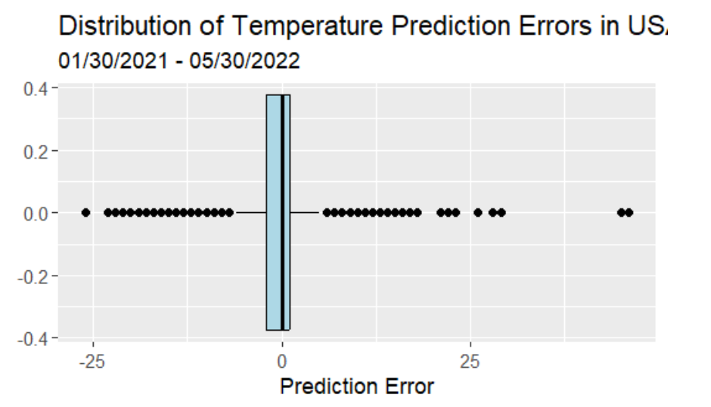
BOXPLOT OF PREDICTION ERRORS
Error = Forecast temperature – Observed temperature

Slide 5
ANALYSIS 1: UNDER- vs OVER- ESTIMATIONS
Extracting outlier:
Prediction errors < first quartile - 1.5 * IQR
Prediction errors > third quartile + 1.5 * IQR
Classifying the outlier:
Errors < lower fence ➔ 0 (Underestimations)
Errors > upper fence ➔ 1 (Overestimations)
Binary classification allow us to fit a Logistic Regression / Extreme Gradient Boosting model

Slide 6
ANALYSIS 1: MODELING
Columns dropped before model fitting:
Date
Observed temperature
Forecast temperature
Observed precipitation
Average annual precipitation
Koppen (climate zone classifier based on local vegetation)

Slide 7
ANALYSIS 1: MODELING
Model 1: Logistic Regression
- LASSO for feature selection and bi-directional stepwise selection for
optimization (AIC)
Model 2: Extreme Gradient Boosting Classifier
- LASSO for feature selection
Result:
Model 1 (Logistic Regression) | Model 2 (Extreme Gradient Boosting)
Accuracy | AUC | Accuracy | AUC
67.5% | 0.708 | 70.4% | 0.768

Slide 8
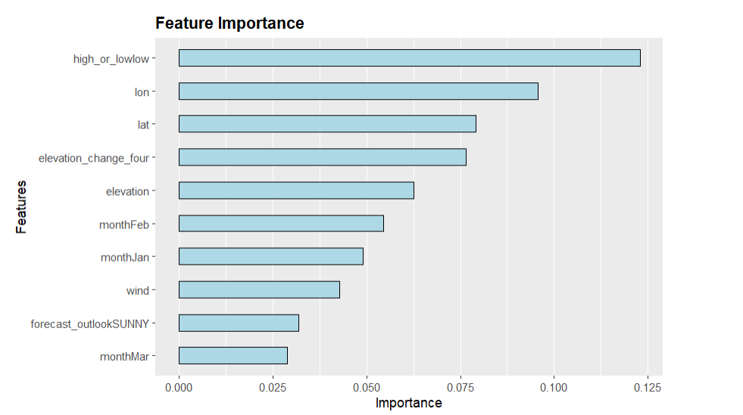
ANALYSIS 1: FEATURE IMPORTANCE

Slide 9
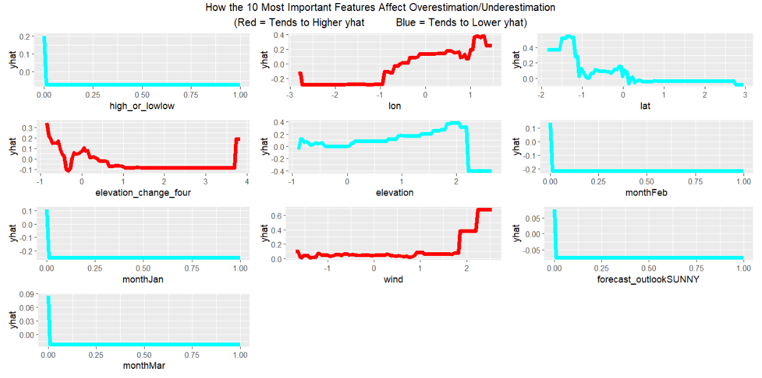
ANALYSIS 1: FEATURE IMPORTANCE

Slide 10
Overestimation | Underestimation
Higher longitude Lower latitude Forecast for high temperature Extremely high or lower ‘elevation_change_four’ Medium to high elevation Higher or extremely low wind speeds | Lower longitude Forecast for low temperature High elevation_change_four Extremely high elevation Forecast made on the month of January, February, or March Sunny forecast outlook

Slide 11
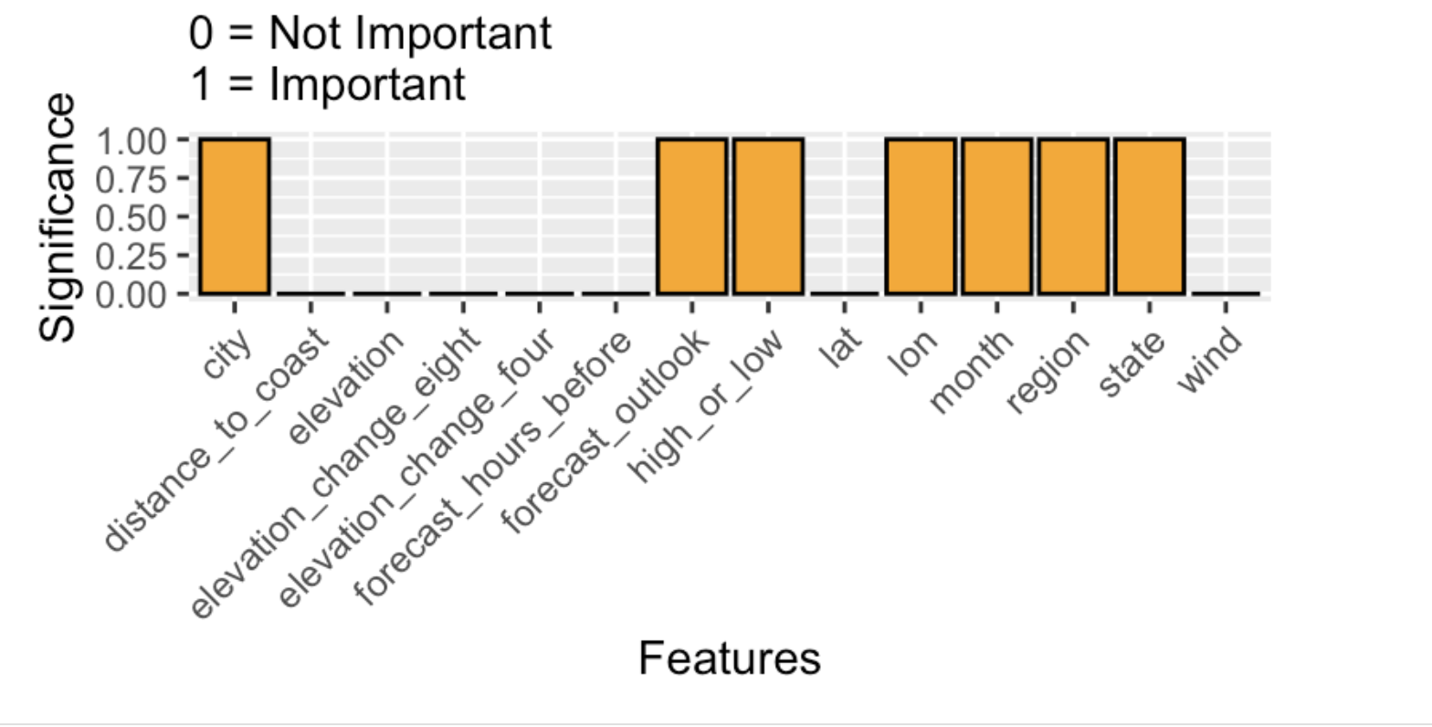
ANALYSIS 2: MORE ACCURATE PREDICTIONS
What factors contribute to more accurate temperature predictions? Our definition of accurate ➔ Data points within boxplot
We utilize a Select KBest algorithm based on linear regression (lm) to perform feature selection

Slide 12
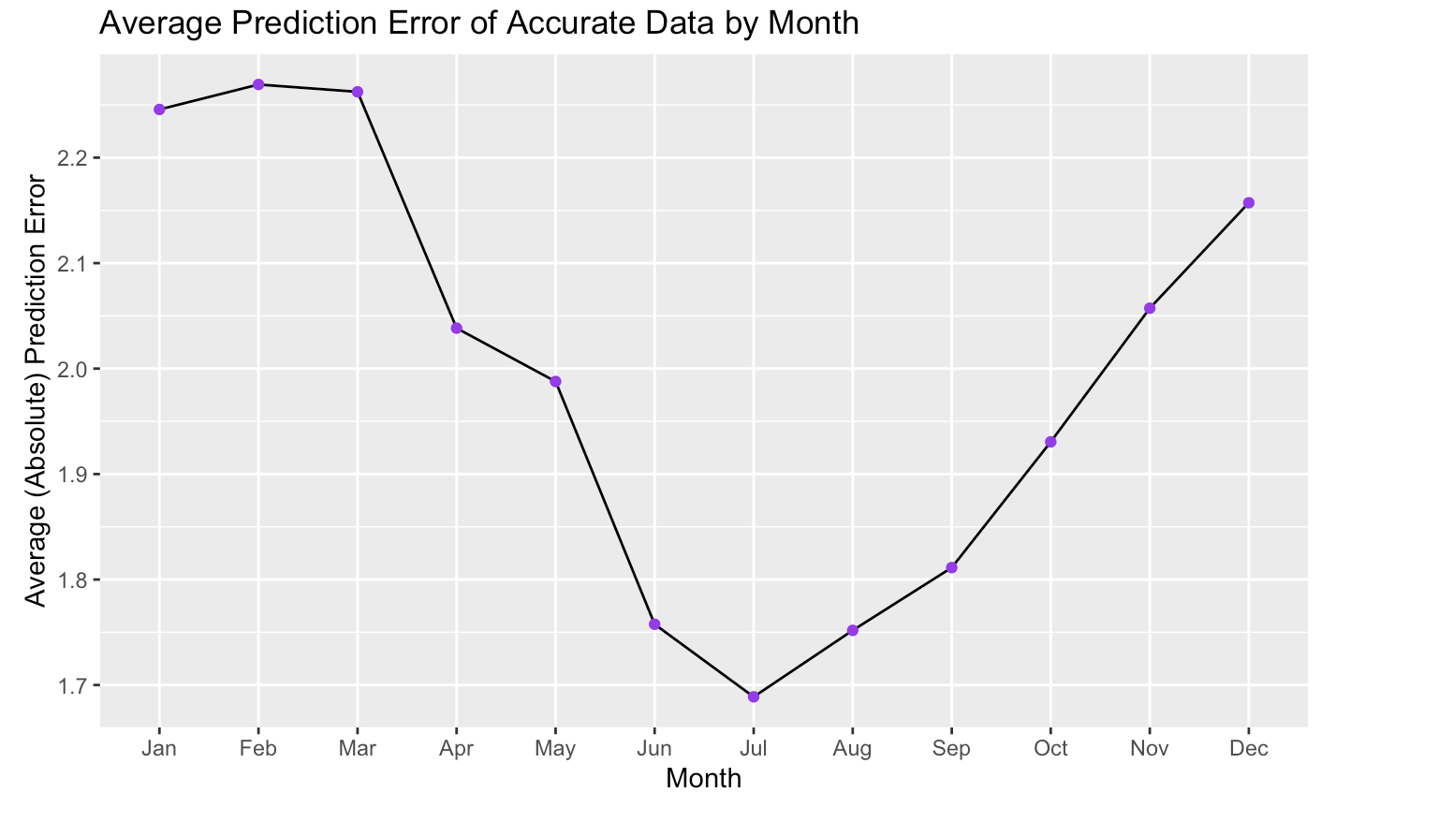
Feature #1: Month

Slide 13
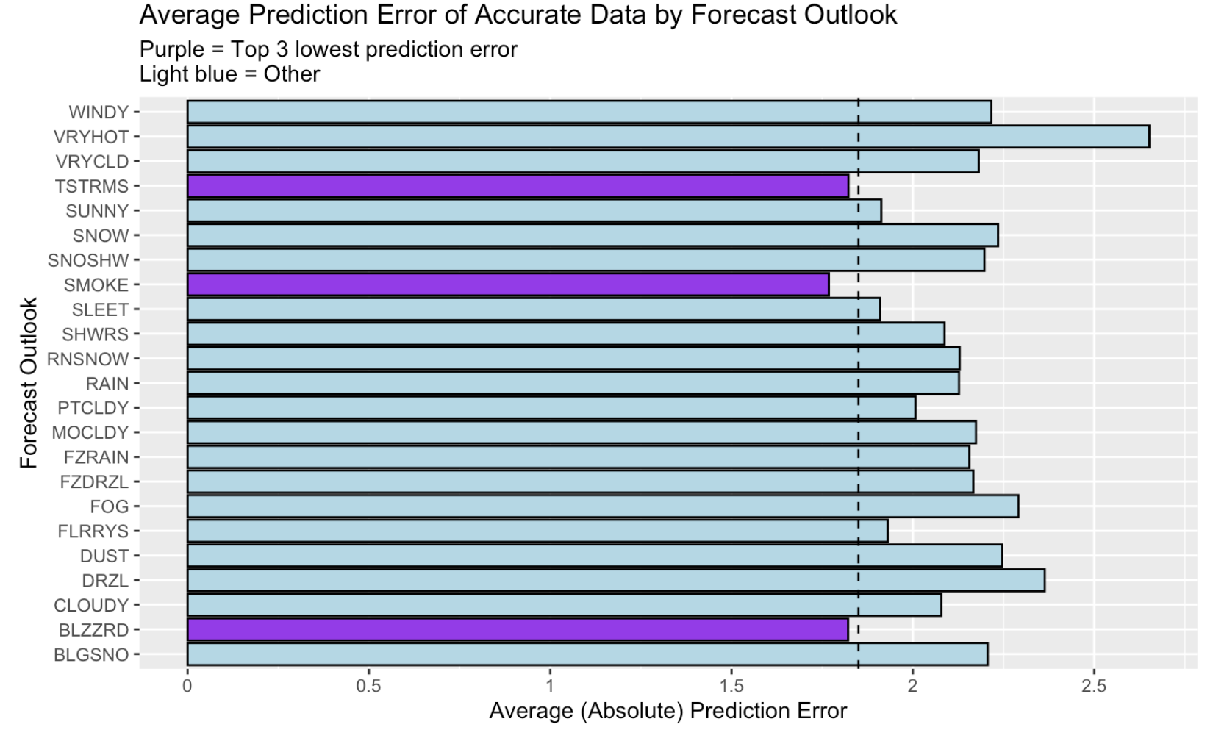
Feature #2: Forecast Outlook

Slide 14
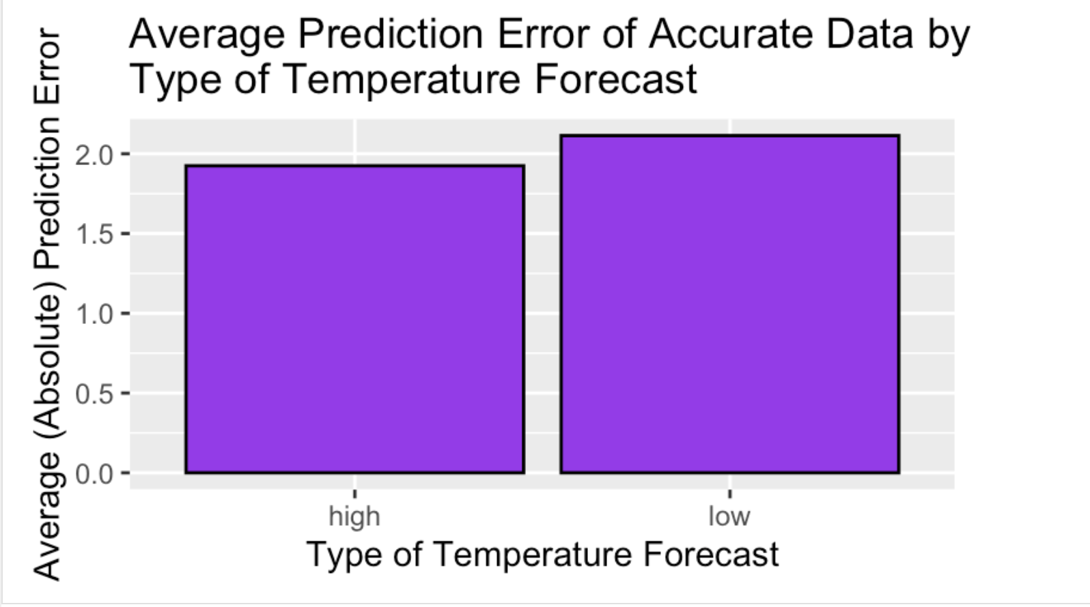
Feature #3: Type of Temperature Forecast

Slide 15
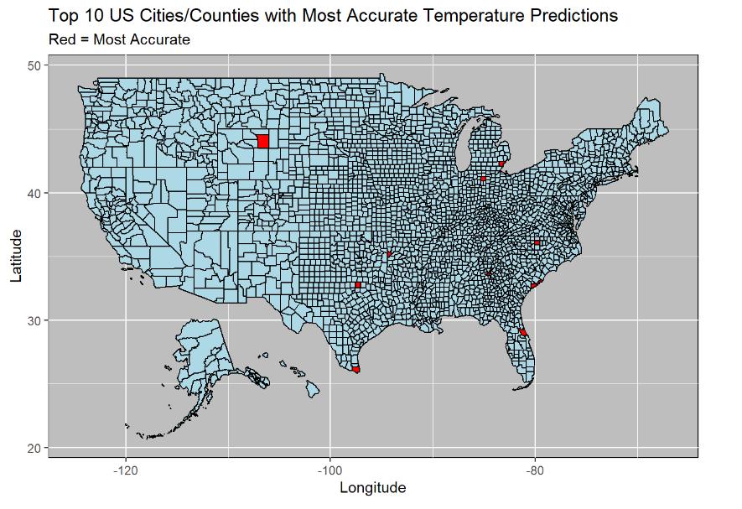
Features #4: Location (City, State, Region, Longitude)

Slide 16
CONCLUSION
Potential Weakness:
Definitions used for accurate, overestimated, and underestimated predictions
Improvements:
Use actual definition by weather forecasters
- Maybe stricter in what they consider accurate, overestimations, and
underestimations
Find a model capable of predicting the errors

